Slide 1
Multiplying with decimals
Arithmetic procedures with integers and decimals

Slide 2
how to use Oak lessons

Slide 3
I can generalise and fluently use written multiplication strategies to calculate accurately with decimals.

Slide 4
A factor is a term which exactly divides another term.
Factorising means to express a term as the product of its factors.
Example
Non example
10 is a factor of 50
8 is not a factor of 10
50 ÷ 10 = 5
10 ÷ 8 = 1.25

Slide 5

Multiplying with decimals
Multiplying with decimals
Appropriate answers to calculations

Slide 6
Multiplying with decimals
There are lots of different ways to multiply two integers together.
There is very little difference between the strategies used to multiply integers together and multiplying decimals together.
However it is important to have the understanding behind each process.

Slide 7


Multiplying with decimals
So let’s start with a simple multiplication.
using an area model.
3
2
The area is 6, so
Let us zoom in a bit…

Slide 8
Multiplying with decimals
Still using our
1
area model
We are going to break up each 1 into ten parts by ten parts.

Slide 9

Multiplying with decimals
In breaking it up, it will allow us to see and understand multiplying by decimals.
1
So let’s, look at an example of

Slide 10
Multiplying with decimals
Here you can see our 2.5
1.3
Here you can see our 1.3

Slide 11


Multiplying with decimals
How can this diagram help us to calculate the decimal multiplication . ?
or
If each larger square is 1,
what does this represent?
or

Slide 12
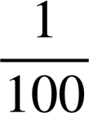

Multiplying with decimals
How can this diagram help us to calculate the decimal multiplication . ?
or
If each larger square is 1,
what does this represent?
or
or

Slide 13
Multiplying with decimals
2.5 × 1.3 =
2
0.5
2
+ 0.5
+ 0.3
+ 0.3
+ 0.15
or
3.25
0.3
0.3
0.15
or

Slide 14
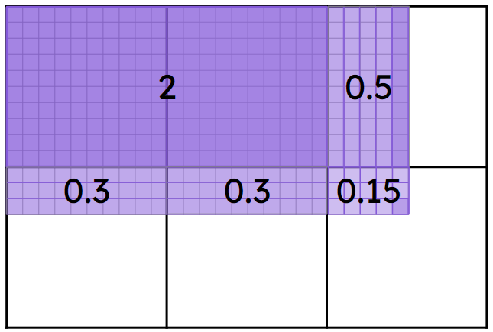

Multiplying with decimals
The area model does not have to be drawn to scale but here it helps to see what happens when you multiply decimals.
× | 2 | 0.5
1 | 2 | 0.5
0.3 | 0.6 | 0.15
2
+ 0.5
+ 0.3
+ 0.3
+ 0.15
3.25

Slide 15


Multiplying with decimals
Now let’s compare the same method to multiplying with integers using
 | 20 | 5
10 | 200 | 50
3 | 60 | 15
× | 2 | 0.5
1 | 2 | 0.5
0.3 | 0.6 | 0.15
2
+ 0.5
+ 0.3
+ 0.3
+ 0.15
3.25

Slide 16

Multiplying with decimals
What do you notice?
We can use the integer multiplication strategy to find the answer to the decimal multiplication by using multiplication or division of powers of 10.
 | 20 | 5
10 | 200 | 50
3 | 60 | 15
To work out
2.5 × 1.3
25 × 0.1 × 13 × 0.1
25 × 13 × 0.1 × 0.1
325 × 0.01 =
3.25

Slide 17

Multiplying with decimals
3.42 is equivalent to:
342 × 100
342 × 0.1 × 0.1
342 × 0.1 × 0.1 = 34.2 × 0.1 = 3.42
0.01 = 0.1 × 0.1
So 342 × 0.01 = 342 × 0.1 × 0.1
342 × 0.01

Slide 18
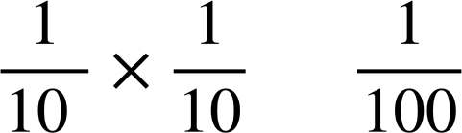
Multiplying with decimals
Dividing by 100 is equivalent to which of the following?
0.1 =
so 0.1 × 0.1 = =
Which is the same as dividing by 100
× 100
× 0.1 × 0.1
0.01 = 0.1 × 0.1 =
Which is the same as dividing by 100
× 0.01

Slide 19
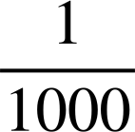
Multiplying with decimals
Which of these will have the same product as 0.52 × 3.18
We know 0.0001 = 0.01 × 0.01
52 × 318 × 0.0001
52 × 0.01 × 318 × 0.01
= 0.52 × 3.18
We know ÷ 1000 = = 0.001
= 0.01 × 0.1
52 × 318 ÷ 1000
52 × 0.01 × 318 × 0.1
≠ 0.52 × 3.18
52 × 0.01 × 318 × 0.01
0.52 × 3.18

Slide 20


Multiplying with decimals
1) Work out the following:
a)
b)
c)

Slide 21
Multiplying with decimals
2) Tick the correct calculations.
A: 52.4 × 1.6 = 524 × 16 ÷ 100
B: 52.4 × 1.6 = 524 × 16 ÷ 10
C: 52.4 × 1.6 = 524 × 16 × 0.01
D: 5.24 × 1.6 = 524 × 16 ÷ 1000
E: 0.524 × 1.6 = 524 × 16 ÷ 1000

Slide 22
Multiplying with decimals
3) Given that
Work out:
a)
b)
c)
45.6 × 12 =
4.56 × 12 =
4.56 × 1.2 =

Slide 23

Multiplying with decimals
Work out the following:
a)
b)
c)
2000
800
1800
100
✕ | 20 | 1
100 | 2000 | 100
20 | 400 | 20
8 | 160 | 8
✕ | 80 | 3
10
1
✕ | 20 | 1
100
20
8
420
✕ | 30 | 7
60
4
30
✕ | 30 | 7
60 | 1800 | 420
4 | 120 | 28
400
80
120
20
800
30
+3
+28
160
80
3
2368
+ 8
913
1
1
2688
1
8.3 × 11 =
83 × 0.1 × 11 =
83 × 11 × 0.1 =
3.7 × 6.4 =
37 × 0.1 × 64 × 0.1 =
37 × 64 × 0.01 =
21 × 0.1 × 128 × 0.01 =
21 × 128 × 0.001 =
913 × 0.1 = 91.3
2368 × 0.01 = 23.68
2688 × 0.001 = 2.688

Slide 24
Multiplying with decimals
2) Tick the correct calculations.
A: 52.4 × 1.6 = 524 × 16 ÷ 100
B: 52.4 × 1.6 = 524 × 16 ÷ 10
C: 52.4 × 1.6 = 524 × 16 × 0.01
D: 5.24 × 1.6 = 524 × 16 ÷ 1000
E: 0.524 × 1.6 = 524 × 16 ÷ 1000

Slide 25

Multiplying with decimals
3) Given that
Work out:
a)
b)
c)
We know 456 × 12 = 5472
So 456 × 0.1 × 12 = 547.2
45.6 × 12 = 547.2
We know 456 × 12 = 5472
So 456 × 0.01 × 12 = 54.72
4.56 × 12 = 54.72
We know 456 × 12 = 5472
So 456 × 0.01 × 12 × 0.1 = 5.472
4.56 × 1.2 = 5.472

Slide 26
Multiplying with decimals
Multiplying with decimals
Appropriate answers to calculations

Slide 27
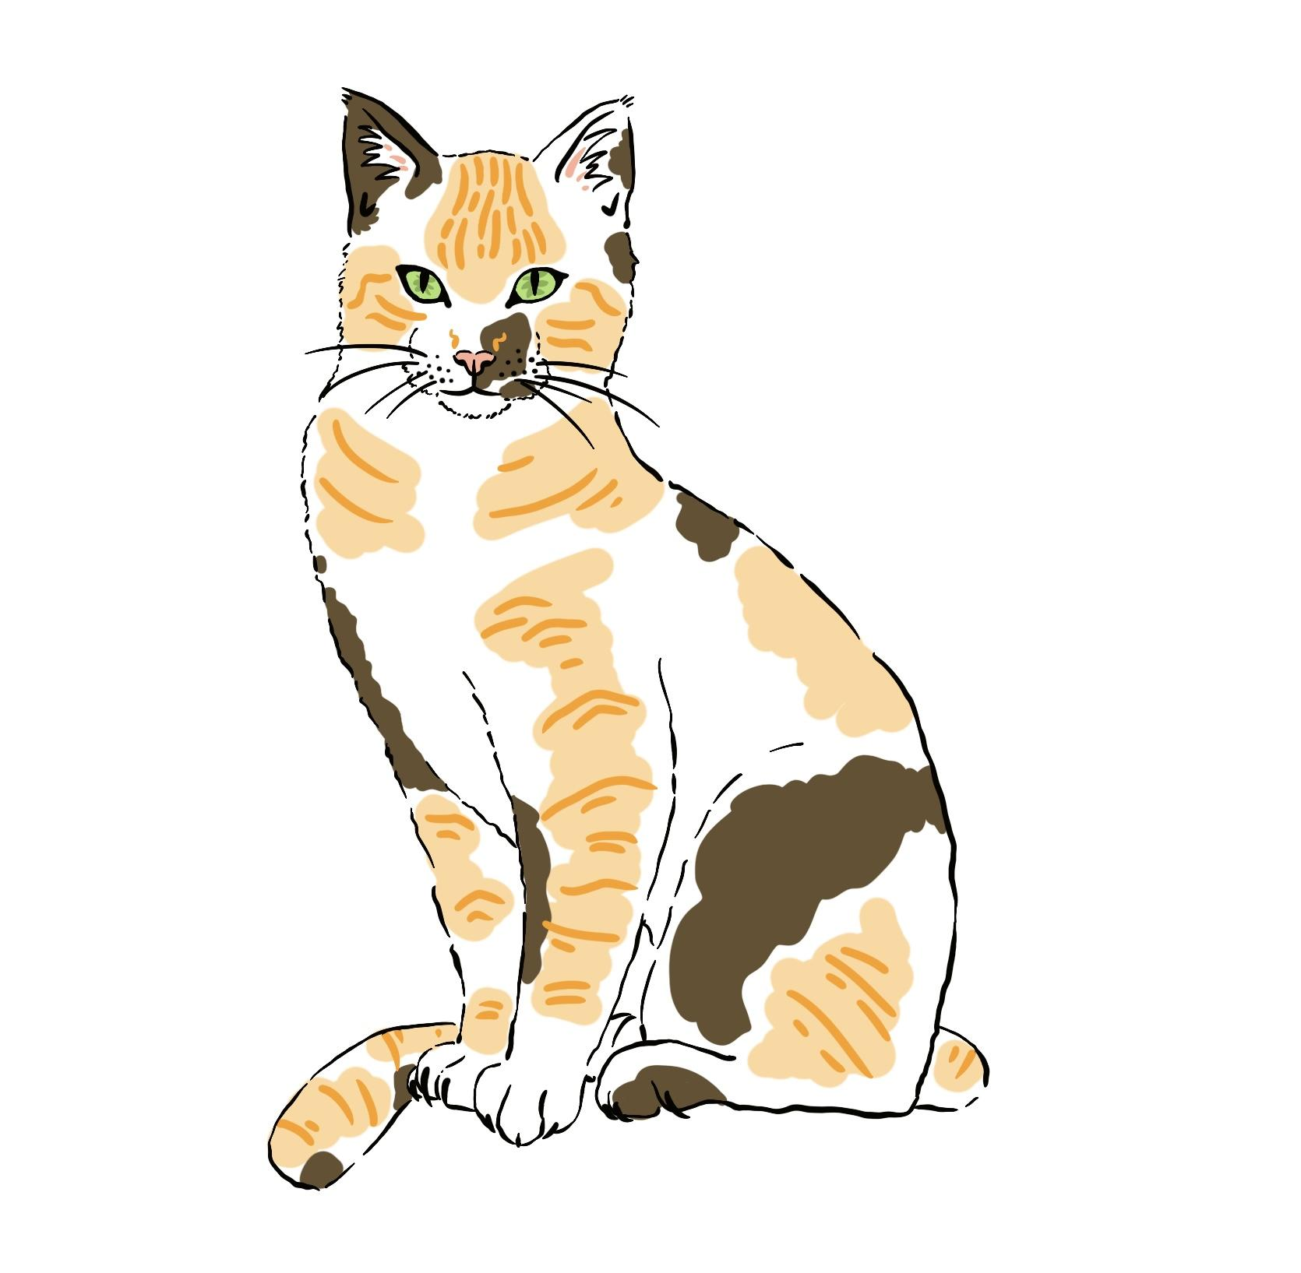

Appropriate answers to calculations
Sometimes we know there is an error by simply looking at the reasonableness of the answer.
It is important to understand the context of the question and reflect on the reasonableness of an obtained answer.
Example
Which weight is an appropriate weight for a cat?
4.2 kg
42 kg
a
b

Slide 28



Appropriate answers to calculations
Sometimes we know there is an error by simply looking at the reasonableness of the answer.
It is important to understand the context of the question and reflect on the reasonableness of an obtained answer.
Example
Which is the correct answer to the calculation?
a
b
Explain your reasoning.

Slide 29
Appropriate answers to calculations
Example
Which is the correct answer to the calculation?
a
b
Explain your reasoning.
Thinking about place value, one answer has a digit in the hundreds place and the highest place value of option b is tens.
Given that we are multiplying numbers that have the highest place value of 5 ones and 3 ones, the answer can’t be in the hundreds.

Slide 30

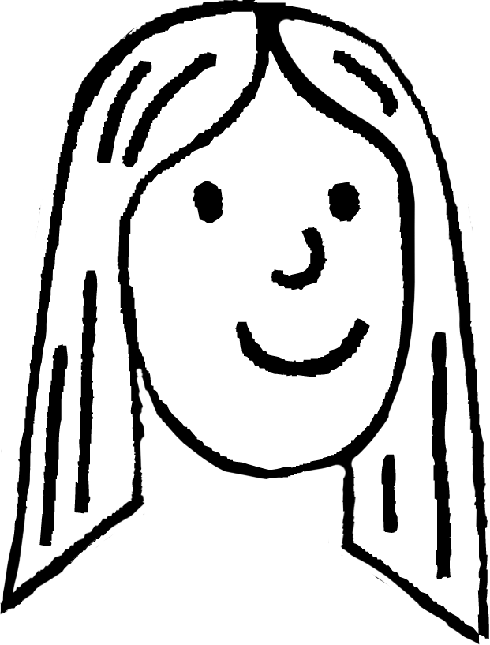
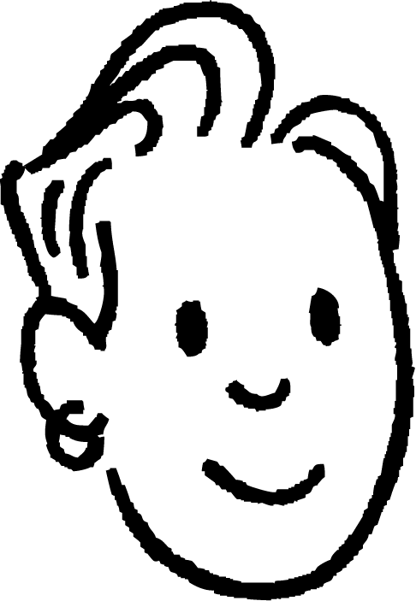
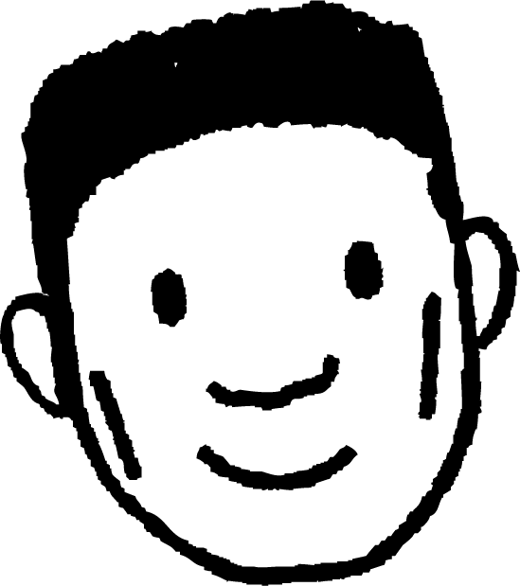
Appropriate answers to calculations
Which student has an appropriate answer to the calculation?
Work out
I worked it out to be 42.12
I worked it out to be 421.2
I worked it out to be 4.212
Laura
Sam
Lucas

Slide 31
Appropriate answers to calculations
Now we know the answer, which calculation could Laura and Alex use to make their answer?
I worked it out to be 42.12
I worked it out to be 421.2
……. ✕ …….
Sam
……. ✕ …….
Laura

Slide 32
Appropriate answers to calculations
I worked it out to be 42.12
I worked it out to be 421.2
32.4 1.3
324 1.3
Laura
……. × …….
……. × …….
3.24 13
32.4 13
……. × …….
……. × …….
324 0.13
3.24 130
……. × …….
……. × …….
There’s an infinite number of calculations to make a product of 42.12
There’s an infinite number of calculations to make a product of 421.2

Slide 33
Appropriate answers to calculations
When place value is considered, it can still remain difficult to identify the correct magnitude of an answer.
A trick is to look at the last digits.
Example
Multiply the last digits together.
27 × 1.3
27 × 1.3
What is the last digit of the product of 7 and 3? Using this, which do you think is the correct answer?
35.2
35.1
35.8
a
b
c

Slide 34
Appropriate answers to calculations
Whether the area method is used or column multiplication, the final digit must end in a 1.
27 × 1.3
27 × 1.3
The product of 7 and 3 is 21, which ends in a 1 or the product of 7 and 0.3 is 2.1, still ending in a 1.
35.2
35.1
35.8
a
b
c

Slide 35

Appropriate answers to calculations
Without calculating, which of the following is the correct answer to the question below? Explain your reasoning.
14.95
14.72
14.58
a
b
c
The product of 4 and 3 is 12, thus ending in a 2 or the product of 0.4 and 0.3 is 0.12, thus ending in a 2.

Slide 36
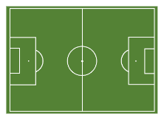
Appropriate answers to calculations
105.3 m
A sports field has a length of 105.3 m by 68.7 m.
68.7 m
Which of the following would you expect to be the correct area of the sports field? Justify your answer.
7234.1 m²
7234.92 m²
723.11 m²
7234.11 m²
a
b
c
d
0.3 ✕ 0.7 gives a 2 decimal place answer
End digit must be 1
Too small
0.3 ✕ 0.7 gives a 2 decimal place answer

Slide 37

Appropriate answers to calculations
Using your knowledge of identifying a reasonable answer and without working out, match the calculation to the correct answer.

Slide 38
Appropriate answers to calculations
2) Are the statements always true, sometimes true or never true? You can use a calculator to help justify your answers.
Statement | Always true | Sometimes true | Never true | Justify
The product of two decimals is always a decimal.
The product of two decimals each with 2 decimal places has 4 decimal places.
The product of two decimals is always smaller than the largest multiplier.

Slide 39
Appropriate answers to calculations
Using your knowledge of identifying a reasonable answer and without working out, match the calculation to the correct answer.

Slide 40
Appropriate answers to calculations
2) Are the statements always true, sometimes true or never true? You can use a calculator to help justify your answers.
Statement | Always true | Sometimes true | Never true | Justify
The product of two decimals is always a decimal.
The product of two decimals each with 2 decimal places has 4 decimal places.
The product of two decimals is always smaller than the largest multiplier.
E.g 1.5 ✕ 2.3 = 3.45
E.g 2.5 ✕ 4.4 = 11
E.g. 1.36 ✕ 1.25 = 1.7
E.g 0.45 ✕ 0.89 = 0.4005
E.g. 4.6 ✕ 1.3 = 5.98
E.g 34.1 ✕ 0.4 = 13.64

Slide 41
Multiplying with decimals
There are lots of different ways to multiply integers. In this lesson we used the integer multiplication strategy to find the answer to the decimal multiplication by using multiplication or division of powers of 10.
When an answer has been calculated, try to consider the magnitude of the answer given the context of a question.

Slide 42

© Oak National Academy 2023.
Produced in partnership with Mathematics in Education and Industry.
Licensed on the Open Government Licence v3.0, except where otherwise stated. See Oak terms and conditions.

